Slide 1
Movies Finder
Chamara Dodandeniya

Slide 2
Content
High-level project design
Technology stack & Best practices
Project structure
Future developments and enhancements
Demo
Notes:
High-level project design – I will explain about high level architect used in this project.
Technology stack - explain about technologies used for build this project
Project structure – will discuss on file structure in backend as well as frontend web application
Future developments - will discuss about the enhancements of this project what are the things we can add to enhance the application, microservice architecture,, monitoring, devops, Jenkins

Slide 3
High-level project design
Why Clean Architecture?
It is a modern Software Design Architecture.
It is Domain centric
It is Loosely copped hence it is provides Portability as well as Flexibility and extendibility
It is independent from frameworks.
It is easy to testable.
It is independent form user interface.
It is independent form database.
Notes:
Introduced in 2012 by Robert Martin
Application logics and entities are completely decoupled from UI or infrastructure
Why didn't try with mvc?
-Big apps built on MVC are hard to debug and modify.
- huge downfall of MVC is that it hardly works with unit tests.

Slide 4
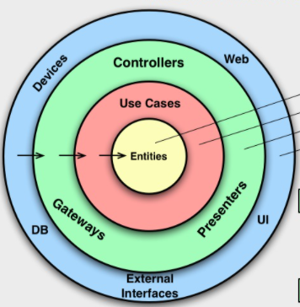
Movies Finder
Backend
Frontend
Web App
(Angular)
API Service
Application
Domain
External Api Endpoints
Omdbapi Endpoint
Infrastructure
Persistence

Slide 5
Name | Description | Project Type | Project Name
Api Service | This is the web API project using to communicate with client-side applications (Mobile apps, web app). | ASP.net core Web API | MFService
Application | In this project, handling business cases and business rules. | ASP.net core Class library | MF.Application
Domain | This project that has knowledge of business cases and business rules. | ASP.net core Class library | MF.Domain
Infrastructure | This is the project, handling external concerns such as middlewares, exception handling, external services ect | ASP.net core Class library | MF.Infrastructure
Persistence | This project handling database concerns. | ASP.net core Class library | -

Slide 6
Technology stack & Best practices
Backend Technologies | Reason
.Net Core 3.1 | As per the initial project requirement. One of the stable .Net Core version.
NSwag | This is Swagger 2.0 API (OpenAPI) toolchain, use for generate REST API documentations.
MediatR | It is a .Net Mediator implementation package and use for CQRS pattern implementation and Event Sourcing.
Newtonsoft.Json | High-performance JSON framework, used for JSON Serialization
RestEase | RestEase is a little type-safe REST API client library and build on top of HttpClient. Having flexibility to customize the client as needed.
XUnit | xUnit.net is a free, open source, community-focused unit testing tool and it is the latest technology use for unit testing .Net languages.
Moq | One of popular mocking library which is use for mocking the services, repositories ect for unit testing.

Slide 7
Technology stack cont…
Frontend Technologies | Reason
Angular | Frontend JavaScript MVC Framework
TypeScript | -
angular/flex-layout | Used for flex-layout designing
angular/material | Providing material ui components

Slide 8

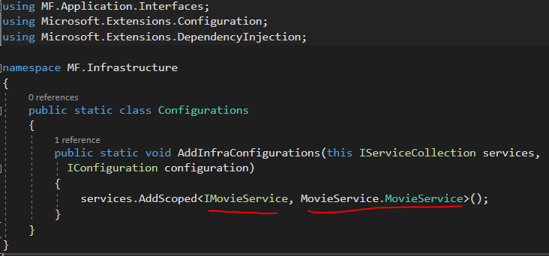
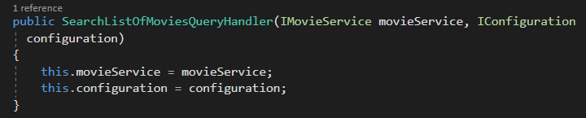
Best practices
DDD – Domain Driven Design
Dependency Injection
Notes:
In the implementation of this application I have followed some best practices.
With using clean Architecture it following Domain centric design (not database centric)
Domain-Driven Design is an approach to software development that centers the development on programming a domain model that has a rich understanding of the processes and rules of a domain.
Basically we need to identify domain, sub domains, business rules when implementing this classes. So developing large enterprises applications, we have to have domain experts how has keen knowledge on the domain and the business.
In our case I have created domain modal classes that include domain entities relates to the Movies
Dependency Injection
In Clean architect, we need to follow dependency inversion principle, because inner layers not depend on the outer layers.
1. High-level modules should not depend on low-level modules. Both should depend on abstractions.
2. Abstractions should not depend on details. Details should depend on abstractions.

Slide 9
Best practices cont…
CQRS (Command Query Responsibility Segregation) Design Pattern
Domain Model
API Interface
Command / Query Handler
UI App
DB
Infrastructure
External API Endpoint
Notes:
CQRS is a software development pattern based on CURD operation processes on different models. One of a popular pattern in recent years
It was developed based on CQS (Command Query Separation)
The main idea of CQS is to separate the interfaces between our operations that read / update the data.
In CQRS, this is added to the separation of our business models.

Slide 10
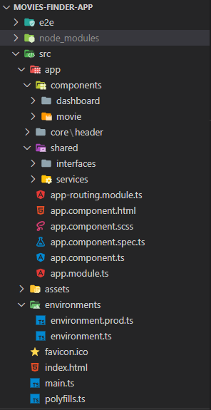
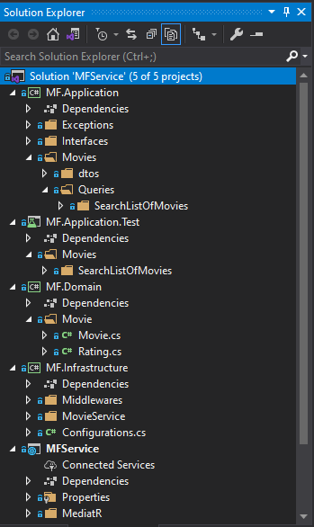
Project structure
Notes:
Will skip this

Slide 11
Future Developments and Enhancements
Let’s add new features to our initial requirement
Microservice Architecture and Why?
High-level diagram of future developments
Security
Scalability and Availability
Application Monitoring
Deployment
Notes:
I have no idea how to extend this app???
Lets talk about how to extend this app
Will discuss about microservice Architecture and it’s benefits
High-level diagram
Security
How to do Scalability and Availability
App Monitoring
Deployment

Slide 12
Future Developments and Enhancements Cont…
New Requirements
System need to provide facilities for users to register to the system.
Users can able to buy movies from the system.
System need to send push notifications to the users when new movies available.
Solution ?
Distributed Systems
Notes:
So we going to change our initial requirement to E-commers application like Netflix

Slide 13
Microservice Architecture and Why?
Microservice are small business services that can work together and can be deployed autonomously / independently.
Independent Services
Better scalability
Technology Diversity
Higher level of agility
Notes:
Strengths of Microservice Architecture
Independent Services: Each service can be deployed and updated independently, providing more flexibility.
An error in a microservic, only has an effect on a specific service Also, adding new features to a microservice application is easier than a monolithic one.
Better scalability: Each service can be scaled independently. Therefore, the entire application does not need to be scaled.
Technology Diversity: Teams do not have to completely choose the technologies on which the services will be developed,
Higher level of agility: Any errors in a microservice application only affect a particular service, not the entire application.

Slide 14
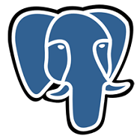


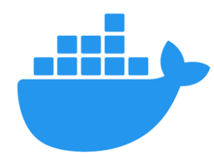

Client Apps
Web
Mobile
Identity Server
API Gateway
Eureka
Microservices
Log Service
MF Service
Cart Service
Notification Service
API
API
API
API
Notes:
Eureka – Service Registry, use for register microservices. (zookeeper)
Using http headers we need to enable cross origin resource sharing
Need to use circuit breakers for omit the domino effect
Gateway is a single entry point for all services, it can use for implement cross cutting concerns such as authentication, authorization, service registry ect
Gateway can expose different APIs for different clients
(Zuul, Netty)

Slide 15
Security
Authentication and Authorization
Protecting Apis
Token based Authentication (JWT)
Single Sign-on
OAuth2
OpenID Connect
Notes:
JWT - JSON Web Token
OpenID Connect – authentication
OAuth2 - Authorization

Slide 16
Scalability and Availability
Vertical or Horizontal scaling
Load balancing
Multiple Replications
Single Point of Failure
Need to be Clusters (sync)
Notes:
Vertical – adding more cpu and Ram
Horizontal – Adding more machines
We need to omit the Single Point of failure
Gateway
Broker
Registry
Identity Server
for that we need to do some horizontal scaling up

Slide 17
Application Monitoring
Need to be a centralized Monitoring system (Dashboard tool like Kibana)
Integrating Health Check API for every service
Status of the DB
Status of the host
Available memory and CPU
Centralized Log Aggregate
Centralized Exception Tracking
Rate limiting (Limiting the Api access)
Alerts

Slide 18
Deployment
Hosting
Physical Server
Virtual Server
On-premise
Cloud
Containers (Docker)
Manage Containers (Kubernetes)
Automate deployment (Jenkins / Azure devops)
Build, Test and Deploy
Environments (Dev, QA, Prod) and Version Controlling
Notes:
We can host one per microservice
Image creating for packaging purpose
Containers will help to move the consistent package and will help to scaleup or down

Slide 19
Demo

Slide 20
Thank You

